Slide 1

UPI Transaction Analysis
Data-Driven Risk & Performance Intelligence
· Data Analytics with GenAI · Capstone Project
- Tanmay mandal

Slide 2
Why this analysis
Growth
Fraud Risk
Reliability
100K transactions · ₹42.4L value
2.0% fraud · 2,000 alerts
5.87% failure rate
OBJECTIVES
01
02
03
04
Analyze transaction behaviour
Identify fraud & failure drivers
Develop executive KPIs
Recommend actions
One question drives the deck: where does risk actually live in a 100K-transaction UPI platform?
2 / 13

Slide 3
The data foundation
upi_transaction_history
100,000
device_info
12,000
PIPELINE
upi_account_details
12,000
customer_master
10,000
Excel
▼
customer_feedback_surveys
4,000
fraud_alert_history
2,000
SQL
▼
Python
merchant_info
500
▼
Statistics
▼
Power BI
7 tables · 138,500 records audited for quality, keys and schema consistency.
3 / 13

Slide 4
Platform at a glance
EXECUTIVE OVERVIEW
100K
₹42.42
5.87%
Total Transactions
Avg Transaction
Failure Rate
2.0%
Feature Phone
Apparel
Fraud Rate
Top Device (2.2% fraud)
Top Merchant (2.2% fraud)
₹42,41,774.26 total transaction value across 12 months.
4 / 13

Slide 5
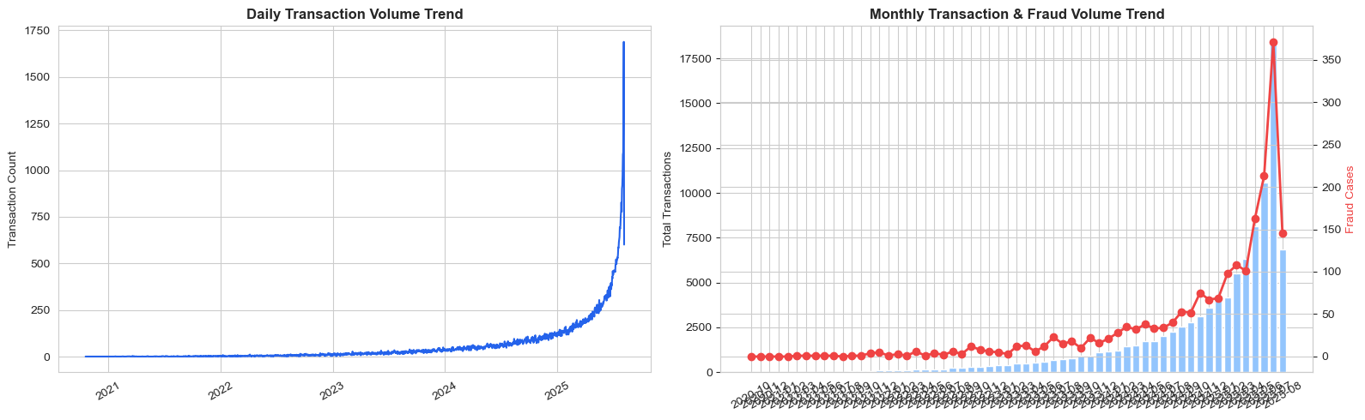
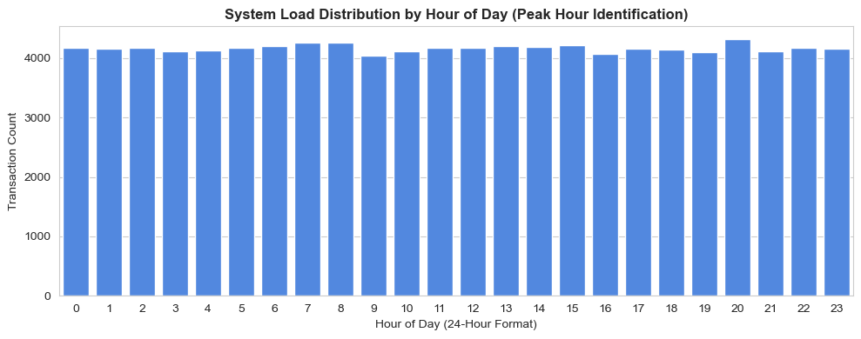
Volume is compounding
WHAT WE SEE
4K → 21K
monthly volume, Sep to Aug
Peak windows
7–8 AM · 1–3 PM · 8–9 PM
~35% of daily volume
Off-peak
1–5 AM — safe maintenance window
5 / 13

Slide 6
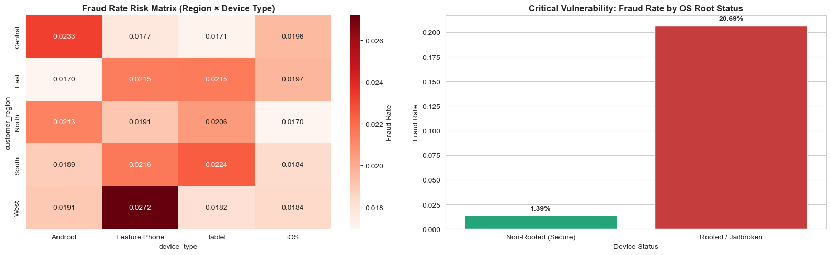
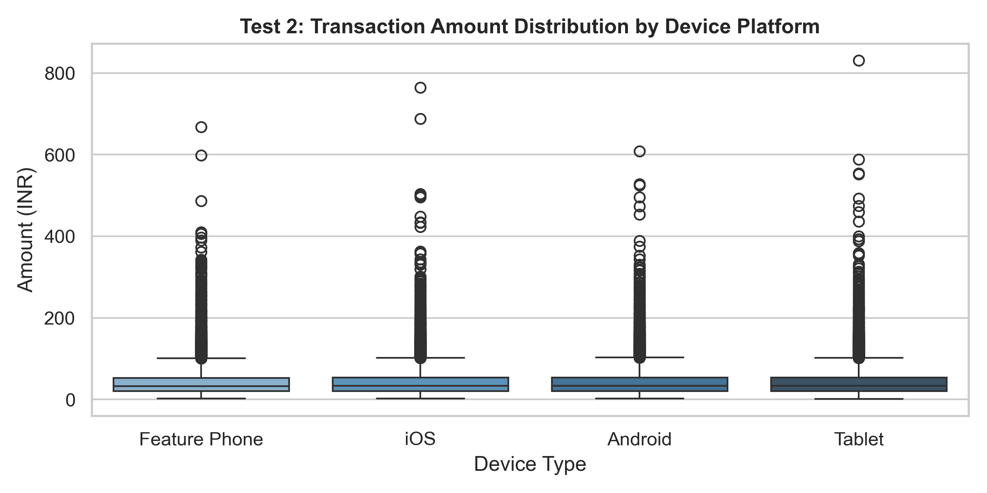
Device integrity is the signal
THE FRAUD SIGNAL
1.39%
20.69%
Secure devices
Rooted / jailbroken
≈15× fraud risk · Chi-square p ≈ 0.000 · Cramér’s V 0.2414
Device type barely moves fraud — root status does.
Feature Phone
2.2%
Tablet
2.0%
Android
2.0%
iOS
1.9%
6 / 13

Slide 7
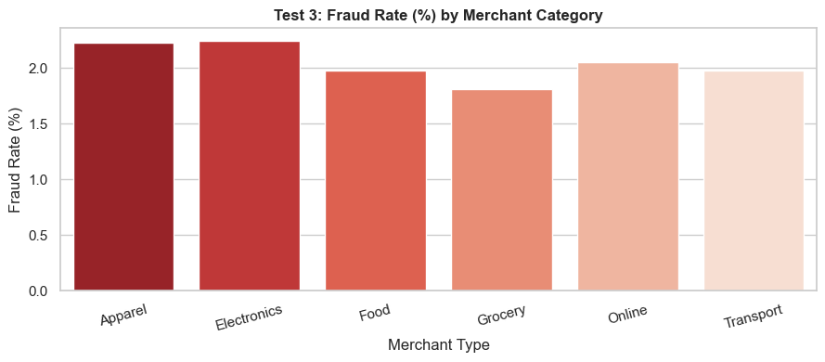
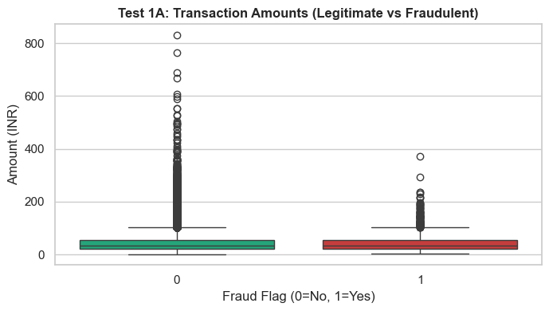
What matters — and what doesn’t
HYPOTHESIS TEST | METHOD | EFFECT SIZE | VERDICT
Fraud rate by device root status | Chi-square | Cramér’s V 0.2414 · medium | Significant
Transaction amount by fraud status | Welch t-test | Negligible | Not significant
Amount: North vs West region | Welch t-test | Negligible | Not significant
Amount across device types | ANOVA | Negligible | Not significant
Fraud rate by merchant type | Chi-square | Negligible | Not significant
Fraud rate by channel | Chi-square | Negligible | Not significant
Transaction status by device | Chi-square | Negligible | Not significant
Customer risk score vs fraud | Point-biserial | r = −0.0016 | Not significant
Only device root status shows a real effect.
7 / 13

Slide 8
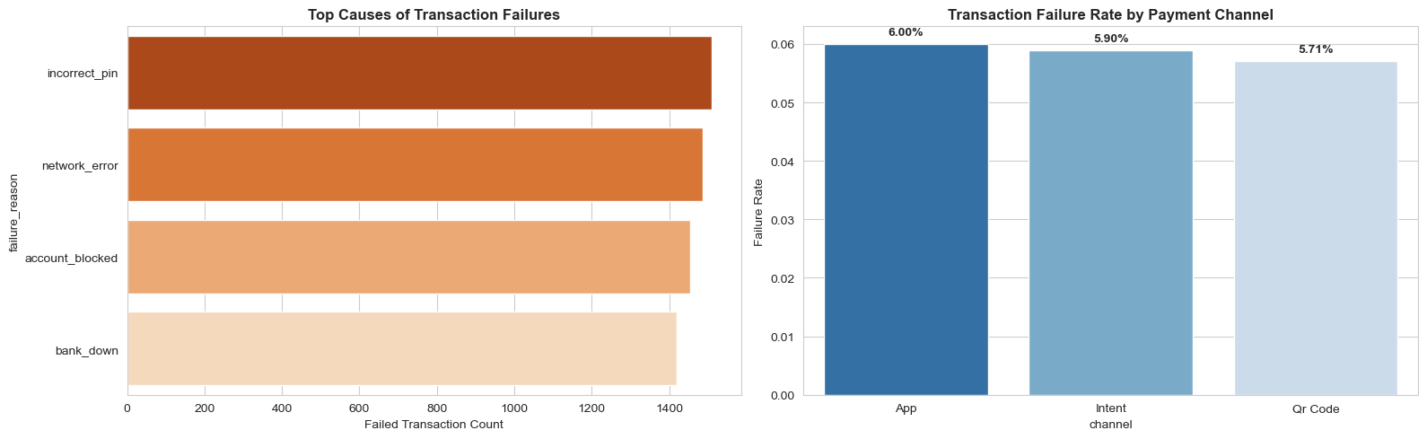
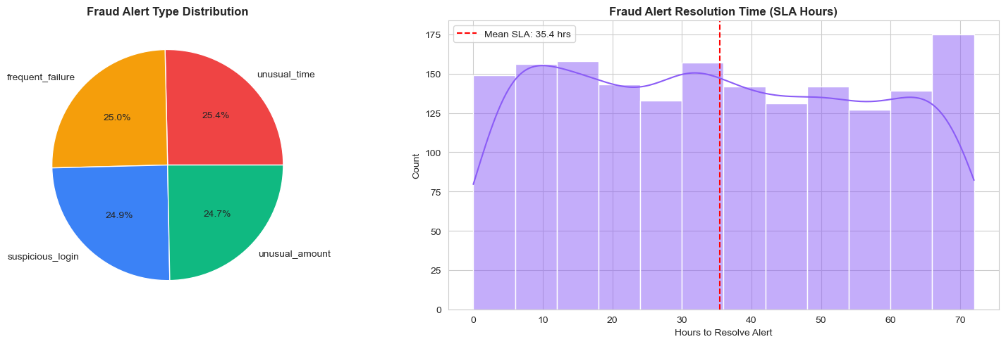
Where transactions break
TOP FAILURE REASONS (RANKED)
1
Incorrect PIN
2
Network Error
3
Account Blocked
4
Bank Down
Ordered by contribution to the 5.87% failure rate.
FAILURE RATE BY CHANNEL
6.00%
5.90%
5.71%
FRAUD ALERT SLA: 87.6% resolved · 35.4 h avg resolution · 248 still open
App
Intent
QR Code
8 / 13

Slide 9
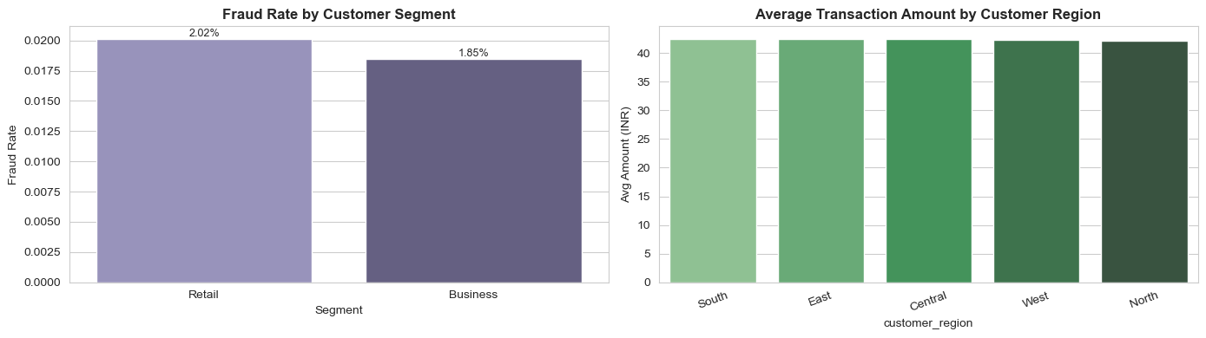
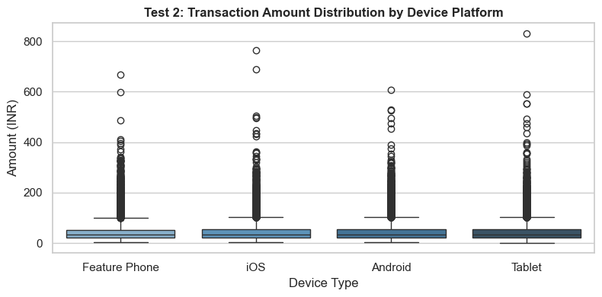
Who transacts, who carries risk
SEGMENT FRAUD RATE
2.02%
1.85%
Retail
Business
MERCHANT TYPES BY FRAUD RATE
Electronics
2.2%
Apparel
2.2%
Grocery
1.8%
7K
501
Active Customers
Active Merchants
Risk sits with device integrity, not customer segment.
9 / 13

Slide 10
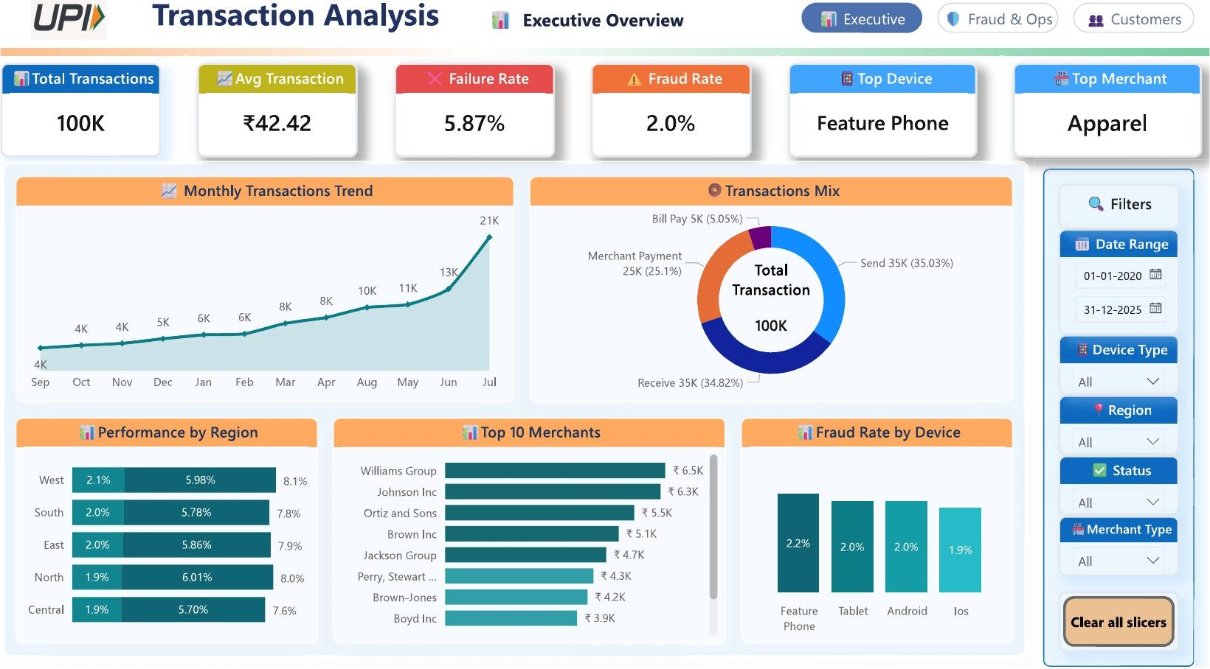
POWER BI · THREE-PAGE DECISION SURFACE
Executive Overview
10 / 13

Slide 11
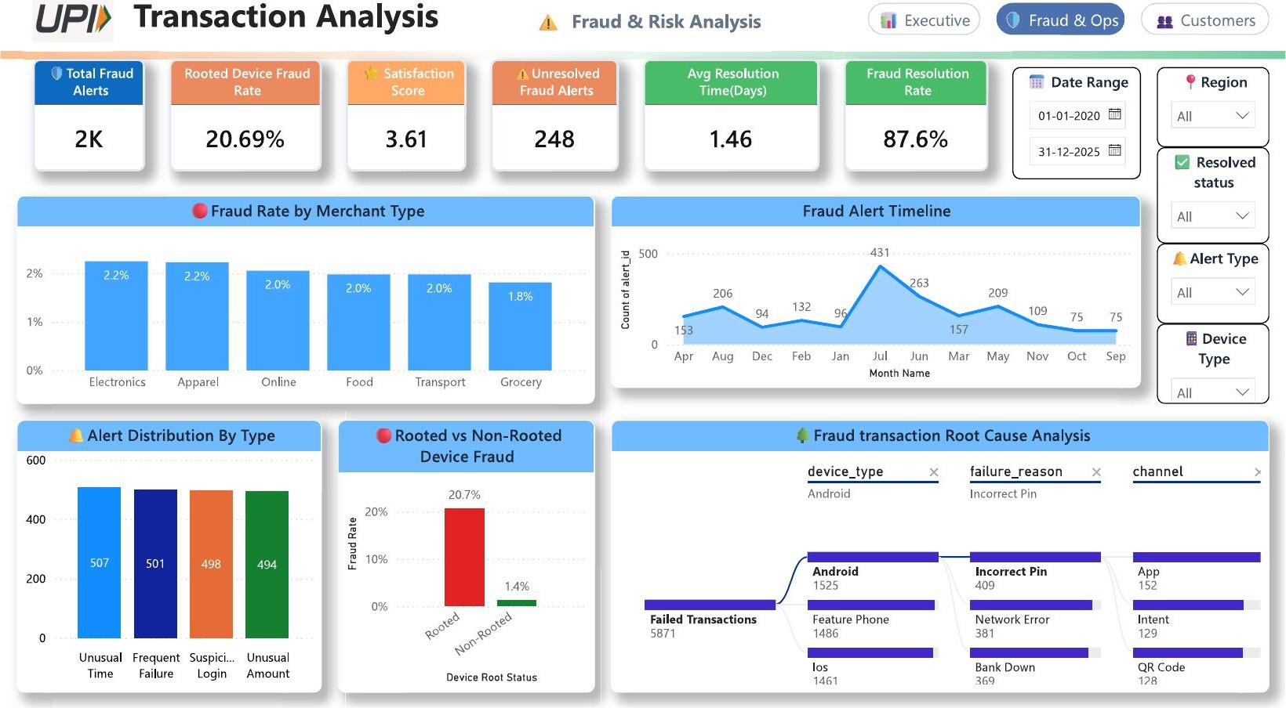
POWER BI · THREE-PAGE DECISION SURFACE
Fraud & Ops
11 / 13

Slide 12
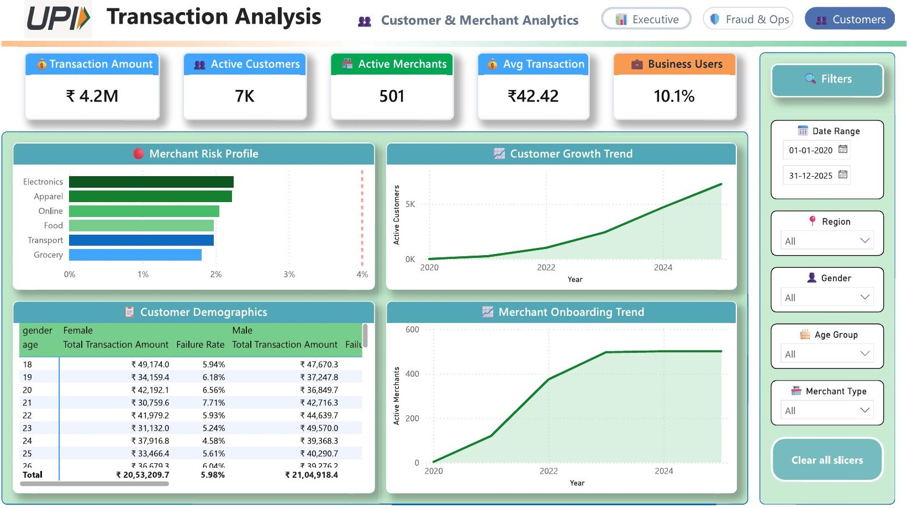
POWER BI · THREE-PAGE DECISION SURFACE
Customers & Merchants
12 / 13

Slide 13
Five moves that change the numbers
Block or step-up rooted devices
~15× fraud risk concentrated here
01
Automate 4-hour fraud triage
35.4 h avg resolution · 248 open
02
Biometric auth to cut PIN failures
Incorrect PIN is failure driver #1
03
Recalibrate risk score with device signals
Current score: r = −0.0016 vs fraud
04
Plan capacity around peak windows
7–8 AM · 1–3 PM · 8–9 PM
05
Thank you
Career 247 · Data Analytics with GenAI · UPI Transaction Analysis

